Slide 1
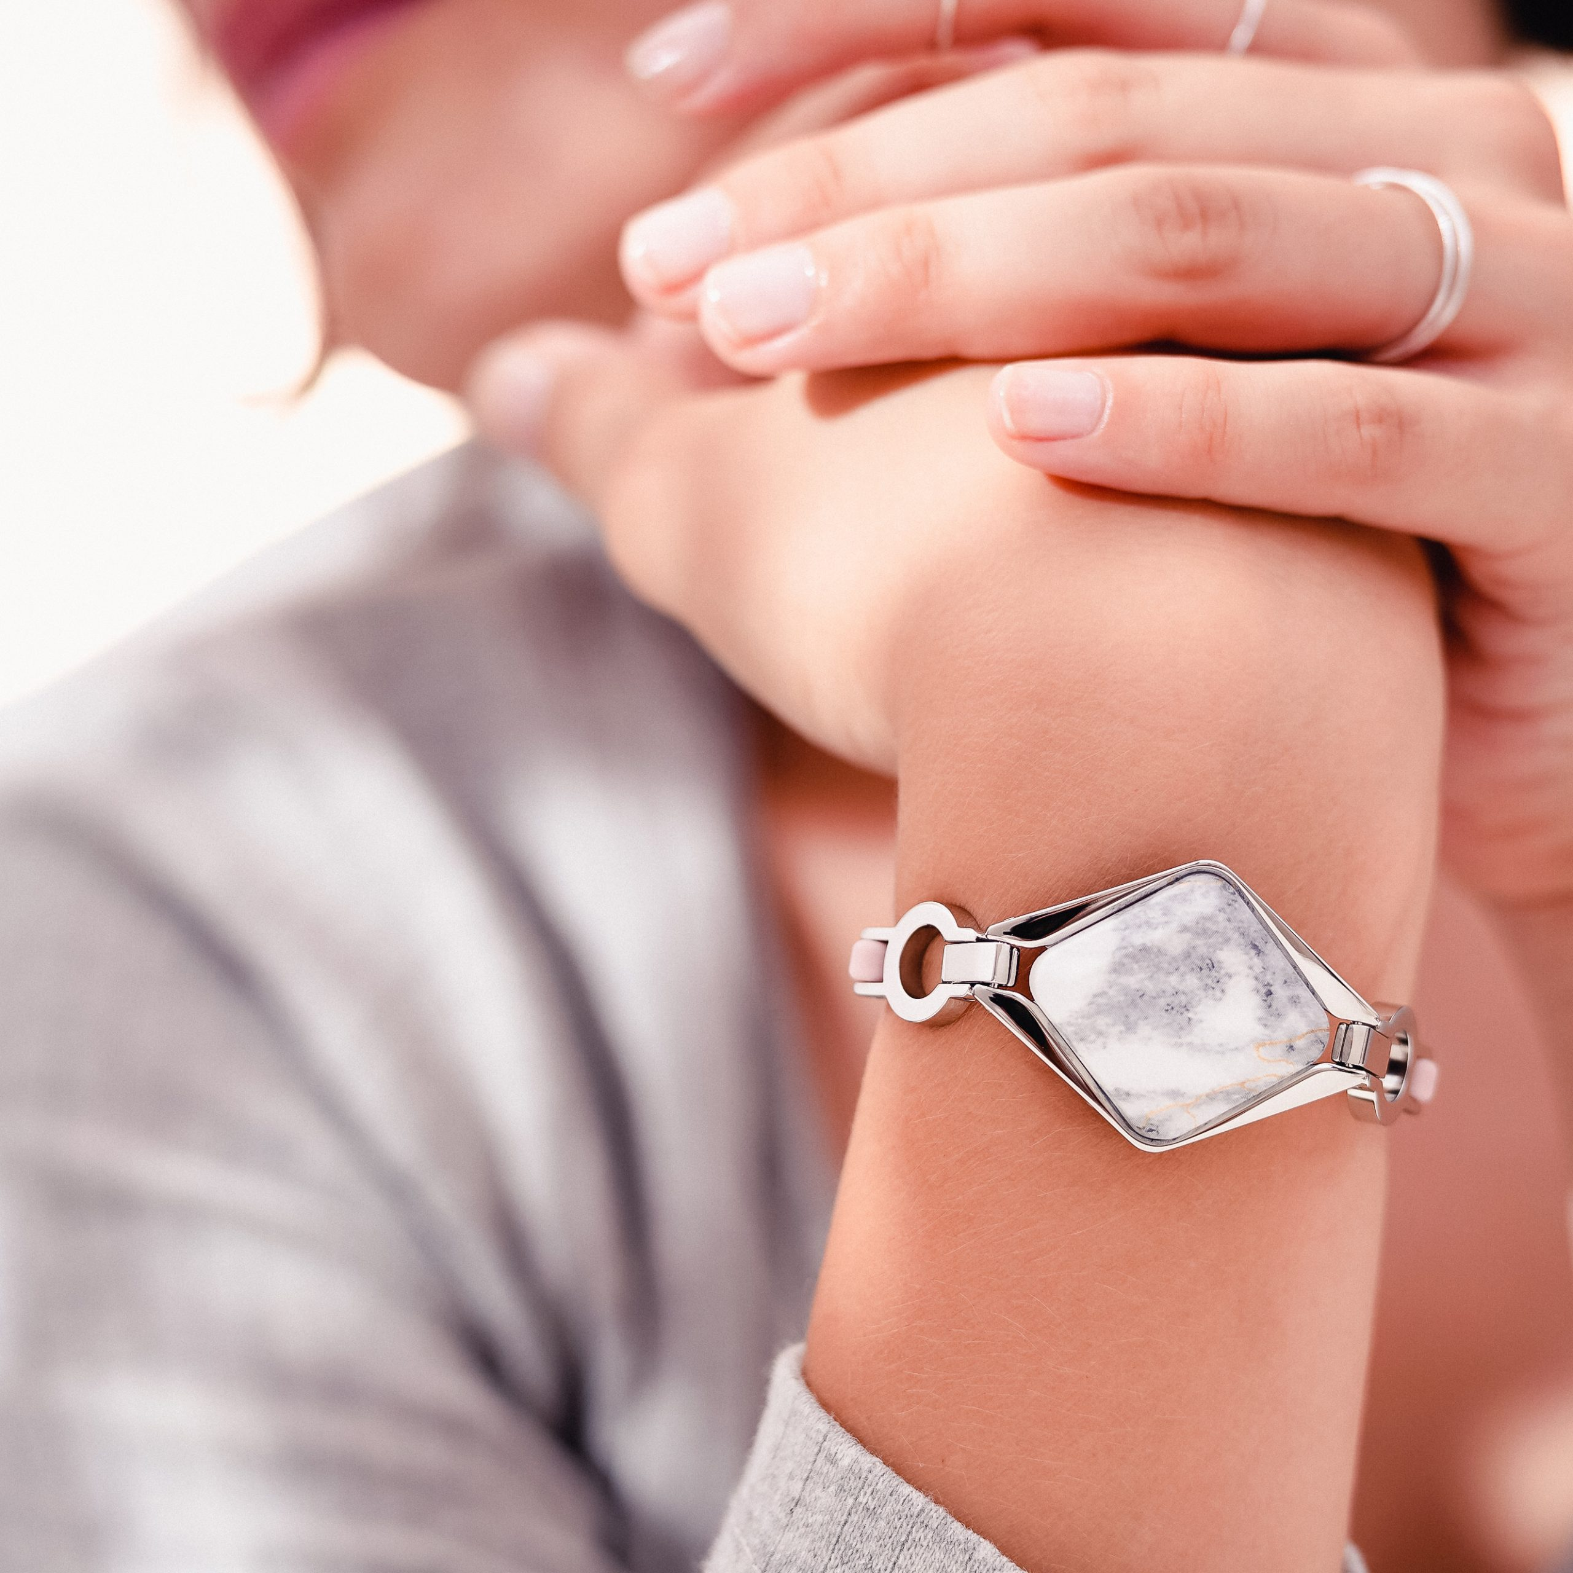
Case Study: Bellabeat Fitness Devices
BY TANNER CALDEMONE FOR GOOGLE CERTIFICATE IN DATA ANALYTICS CAPSTONE PROJECT JUNE 2024
Image from bellabeat.com

Slide 2
Table of Contents
Ask – The Business Task 6
Prepare – Datasets & Sources 8
Process – Cleaning & Formatting 10
Analyze & Share – Key Insights 16
Act – Recommendations & Takeaways 18
2

Slide 3

Since it was founded in 2013, Bellabeat has grown rapidly and quickly positioned itself as a tech-driven wellness company for women
They offer different smart devices that collect data on activity, sleep, stress, and reproductive health
This data can help empower women with knowledge about their own health and habits
Image from bellabeat.com
3

Slide 4
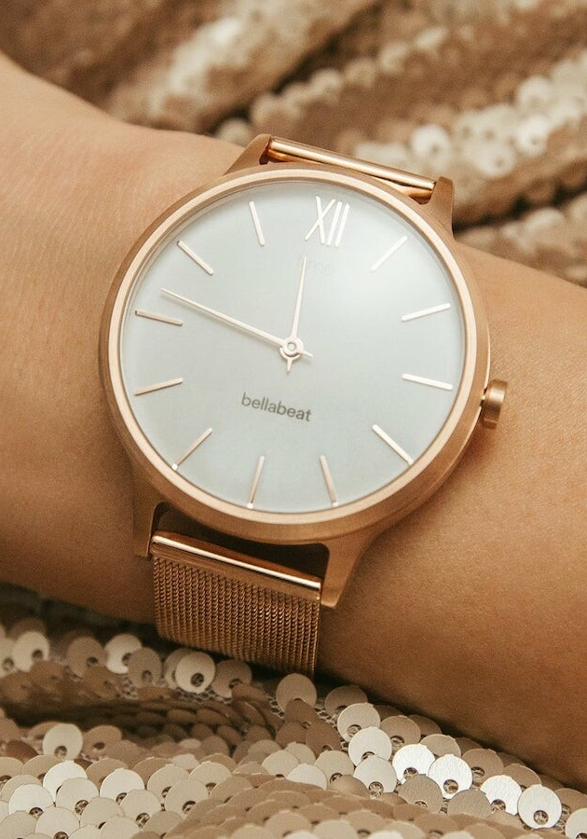
Bellabeat Time
This wellness watch combines the timeless look of a classic timepiece with smart technology to track user activity, sleep, and stress
The Time watch connects to the Bellabeat app to
provide the user with insights into their daily wellness
Image from bellabeat.com
4

Slide 5

Bellabeat Leaf
Bellabeat’s classic wellness tracker that can be worn as a bracelet, necklace, or clip
Like the Time, the Leaf tracker connects to the Bellabeat app to track activity, sleep, and stress
Image from bellabeat.com
5

Slide 6
Ask – The Business Task
Analyze consumer usage trends of non-Bellabeat smart devices and provide high-level recommendations for Bellabeat’s marketing strategy
Stakeholders
Urška Sršen - Bellabeat co-founder and Chief Creative Officer
Sando Mur - Bellabeat co-founder and key member of the Bellabeat executive team
Bellabeat Marketing Analytics Team
6

Slide 7
Applying the knowledge from the Google Data Analytics Program, we
can use all of the tools and strategies to solve the Business Task
and provide high-level recommendations for Bellabeat's marketing strategy.
Key Questions
What are the current trends in smart device usage?
How could these trends apply to Bellabeat customers?
How could these trends help influence the Bellabeat marketing strategy?
7

Slide 8
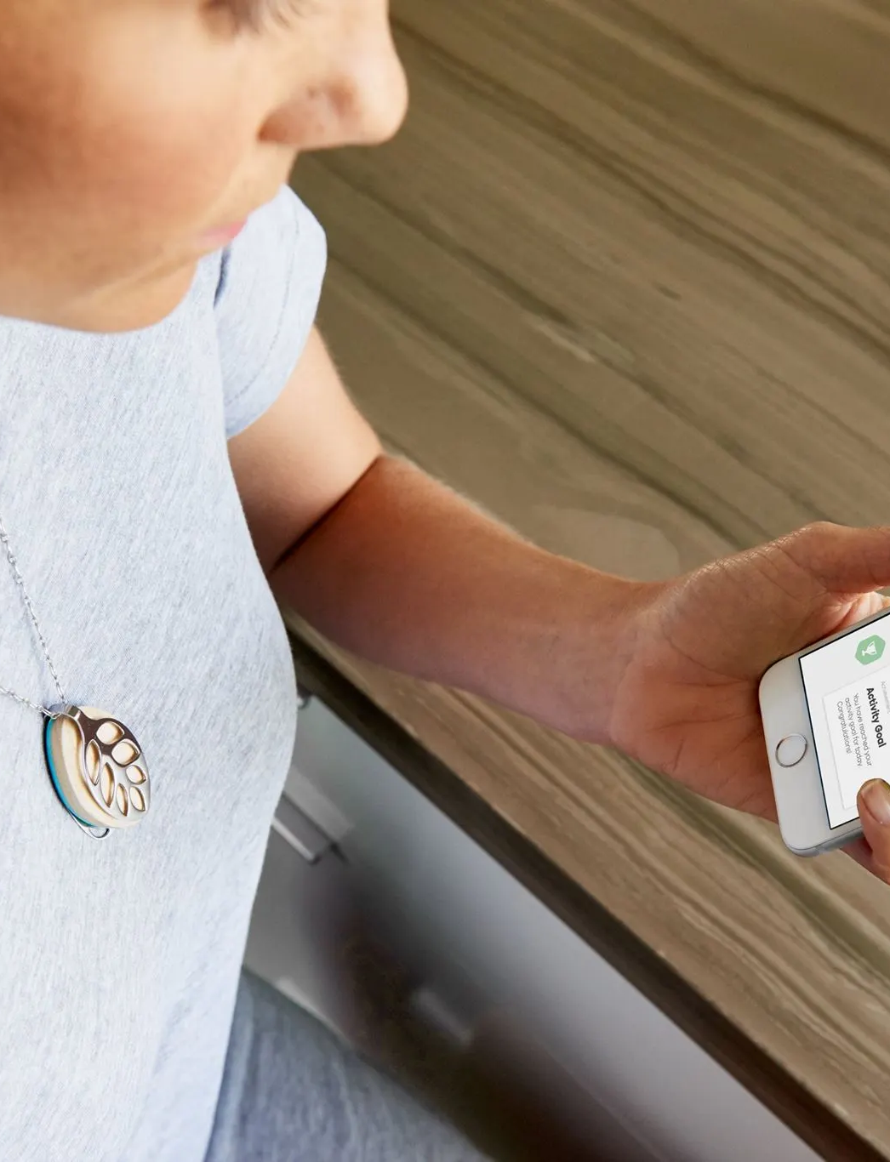
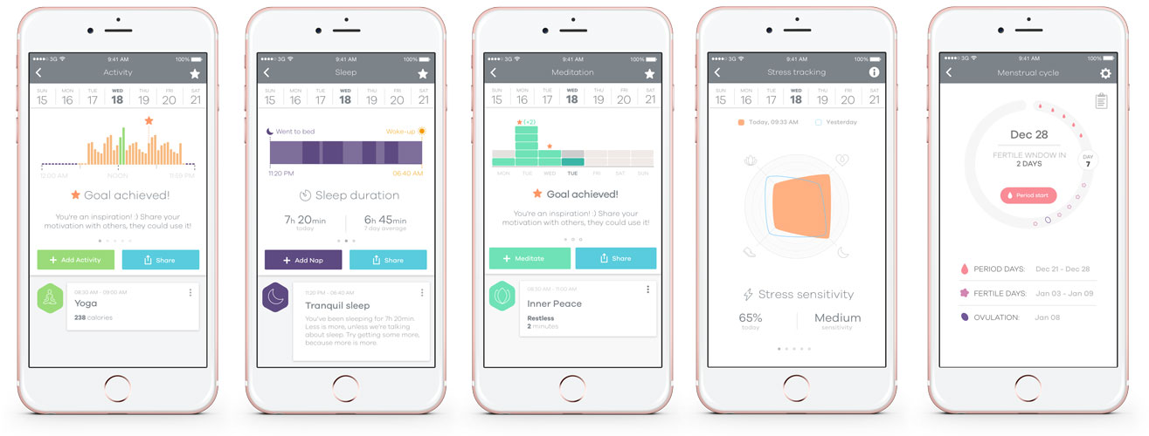
Prepare – Datasets & Sources
Image(s) from bellabeat.com
8

Slide 9
Data Sources (Raw Data)
Dataset A – Fitbit Fitness Tracker Data
Click here for the dataset description from Kaggle:
“This dataset generated by respondents to a distributed survey via Amazon Mechanical Turk between 03.12.2016-05.12.2016. Thirty eligible Fitbit users consented to the submission of personal tracker data, including minute-level output for physical activity, heart rate, and sleep monitoring.”
Limitations
This dataset only consisted of 30 users across 30 days
Notable gaps in tracking occurred as well
There was no ability to follow up with the stakeholders or original researchers
Questions about outliers and parameters couldn’t be answered
No location was given to indicate the market context for the dataset
No demographic was given to focus on women or compare age groups
9

Slide 10
Process – Cleaning & Formatting
Preliminary Cleaning & Formatting
File Storage
Hierarchy by Time Increments
Consistent Naming Conventions
Excel: Formatting for Data Types
SQL: Combining Four “Daily” Files
Excel: Cleaning Data
Removed Extreme Outliers
Data Manipulation & Examination
Expected Trends Were Generally Confirmed Without Bias
More steps recorded generally aligned with more calories burned
Lower calories burned aligned with fewer steps recorded
Correlations/Trends in Sleep Cycles
Observed trends between sleep or time awake in bed
Correlated sleep against heavy vs. light activity during the day
Data only spanned 30 days, therefore most correlations were deemed insufficient
10

Slide 11
Fitbit User Results
Saturday Afternoons were the most active time on average by intensity
The most steps were logged midweek (Tues-Thrs) with the most being on Tuesday
11

Slide 12
Sleep Tracking by Age
Use It Regularly
Use It Occasionally
Used It Once
Interested In Using It
Don’t Use It
12

Slide 13
Nutrition Tracking vs. Sleep Tracking by Age
13

Slide 14
Weekly Activity Regimen
35.85% of the users maintain a very active regimen throughout the week
62.87% of users engage in light (31.7%) or moderate (32.45%) physical activity throughout the week
A small number of users (1.28%) are sedentary throughout the week
14

Slide 15
Minutes of Activity
15

Slide 16

Analyze & Share – Key Insights
The majority of users (62.87%) have light or moderate activity
There are some very active users (35.85%) who burn more than 2500 calories, which is an active segment that we could offer subscription plans, challenges, etc
There is a minority of users (1.28%) that burn less than 1000 calories, which means that they use the smartwatch as more of an aesthetic than a fitness tracker
Image from bellabeat.com
16

Slide 17
Two Clear Segments are Known
More than 1000 minutes of activity per week: Most active segment of users
These users can be offered challenges and personalized plans to exercise harder that can net them rewards, etc
Less than 1000 minutes of activity per week: Very sedentary users
This segment should launch offers of 1-week plans or small, low-commitment challenges so that they start moving more
17

Slide 18

Act – Recommendations & Takeaways
Segmenting users is key to understanding the type of product or service that is being utilized
To offer segmentation allows models to be forecasted to calculate abandonment rates, products, and services which will help the customers
Image from bellabeat.com
18

Slide 19
Promote the Very Active Segment:
Offer challenges/competitions, personalized plans, a rewards system, etc
Promote the Moderately Active Segment:
Send notifications for small commitments, such as getting up and stretching, walking 5000+ steps/day, etc
Offer free challenges to users to overcome week by week and ascend to the Very Active Segment
Communicate with the Users:
To identify better Marketing campaigns, send notifications and emails to users who do not consistently use the app or product
19

Slide 20
Thank you

